Slide 1
SURVEY DESIGN
The Problem
Consider a company that sells k products and has a database containing the purchase histories of a large number of customers.
The company wishes to conduct a survey, sending customized questionnaires to a particular group of n of its customers, to try determining which products people like overall.

Slide 2
Here are the guidelines for designing the survey.
Each customer will receive questions about a certain subset of the products.
A customer can only be asked about products that he or she has purchased.
To make each questionnaire informative, but not too long so as to discourage participation, each customer i should be asked about a number of products between ci and ci’.
Finally, to collect sufficient data about each product, there must be between pj and pj’ distinct customers asked about each product j.

Slide 3
Input to the Survey Design Problem consists of a bipartite graph G whose nodes are the customers and the products, and there is an edge between customer i and product j if he or she has ever purchased product j.
for each customer i = 1, . . . , n, we have limits ci ≤ ci’ on the number of products he or she can be asked about.
for each product j = 1, . . . , k, we have limits pj ≤ pj’ on the number of distinct customers that have to be asked about it.
The problem is to decide if there is a way to design a questionnaire for each customer so as to satisfy all these conditions.

Slide 4
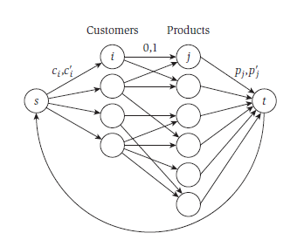
Designing the Algorithm
To obtain the graph G’ from G, we orient the edges of G
from customers to products, add nodes s and t with
edges (s, i) for each customer i = 1, . . . , n, edges (j, t) for
each product j = 1, . . . , k, and an edge (t, s).
The flow on the edge (s, i) is the number of products included on the questionnaire for customer i, so this edge will have a capacity of ci’ and a lower bound of ci.
The flow on the edge (j, t) will correspond to the number of customers who were asked about product j, so this edge will have a capacity of pj’ and a lower bound of pj.

Slide 5
Each edge (i, j) going from a customer to a product he or she bought has capacity 1, and 0 as the lower bound. The flow carried by the edge (t, s) corresponds to the overall number of questions asked. We can give this edge a capacity of ∑i ci’ and a lower bound of ∑i ci.

Slide 6
Analyzing the Algorithm
The graph G just constructed has a feasible circulation if and only if there is a feasible way to design the survey.
Proof. The edge (i, j) will carry one unit of flow if customer i is asked about product j in the survey, and will carry no flow otherwise.
The flow on the edges (s, i) is the number of questions asked from customer i.
The flow on the edge (j, t) is the number of customers who were asked about product j, and finally.
The flow on edge (t, s) is the overall number of questions asked.
Customer i will be surveyed about product j if and only if the edge (i, j) carries a unit of flow.

Slide 7
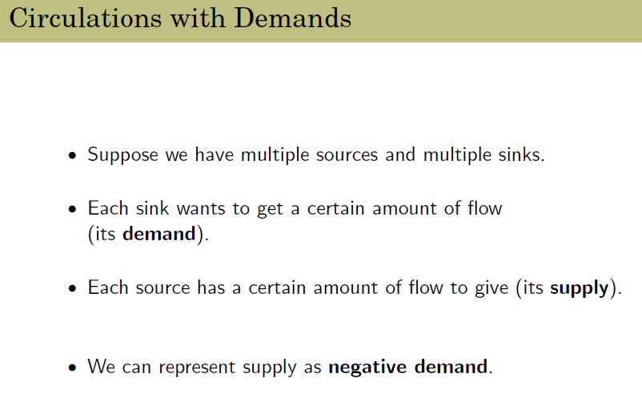
This flow satisfies the 0 demand, that is, there is flow conservation at every node.
NOTE:

Slide 8
We assume that demand and supply are perfectly matched overall. that is,
∑v dv = 0. (dv is the demand of the vertex v).
Our goal is to find a flow such that everyone's demand is met (exactly), while incurring the minimum total transportation cost.

